Slide 1
Basic I/O Interfacing 8255 or 82C55
‹#›

Slide 2
The programmable peripheral Interface
The 82C55 programmable peripheral interface (PPI) is a very popular low-cost interfacing component that is used found in many applications.
Applications range from 7-segment display, stepper motor connection, counters to key pad management.
This device is still in use today and is used to interface and detect key presses on modern keyboards, parallel printers and other interfacing chipsets.
For those of you who are doing computer interfacing course you will be extensively using this device to interface various devices with the PC.
‹#›

Slide 3
Active Low
Active High

Slide 4
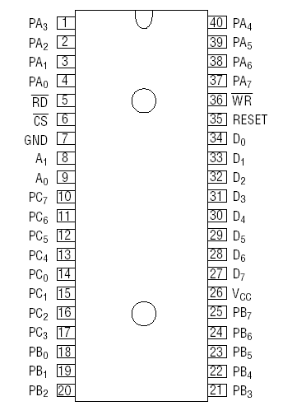
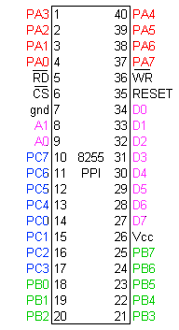
Pin Diagram 8255
(PA0 – PA7) Port A
(PB0 – PB7) Port B
(PC0 – PC7) Port C
(D0 – D7) Data Pins
‹#›

Slide 5
Pin Diagram 8255
(PA0 – PA7) Port A
(PB0 – PB7) Port B
(PC0 – PC7) Port C
(D0 – D7) Data Pins
1. CS’ = 0 (CPU Activates 82C55)
2. A1= 1, A0 = 1 (CPU Configures 82c55)
D0 – D7 = Control Bits
Port A, B, C is selected by A1, A0 depending on need
3 Types of peripheral Devices
Low Level – Port A, B, C
High Level Uni Direction – Port A, B
High Level Bidirectional – Port A
‹#›

Slide 6
82C55
CS pin is used to select the device for reading or writing.
Control lines A0 and A1 are used to select the Port that requires interaction.
A1 | A0 | Function
0 | 0 | Port A
0 | 1 | Port B
1 | 0 | Port C
1 | 1 | Command Registers
‹#›

Slide 7
Operation modes:
BIT SET/RESET MODE:
The PORT C can be Set or Reset by sending OUT instruction to the CONTROL registers.
I/O MODES:
MODE 0(Simple input / Output):
MODE1 (Input/ Output with Handshaking)
MODE2 (bi directional Input/ Output with Handshaking)
Port A can work in All mode (Mode 0, Mode1, Mode 2)
Port B can work in All mode (Mode 0, Mode1, Cannot work in Mode 2)
Notes:
Output are latched: Will be giving same output until we change it like a memory.
Inputs are buffered: Just keep the power level of input but will not store like latch.
‹#›

Slide 8
FOR I/O MODE:
The mode format for I/O as shown in figure
D7 | D6 | D5 | D4 | D3 | D2 | D1 | D0
Group A
Port C Upper 1=Input 0=Output
Port A 1=Input 0=Output
Mode selection 00=mode 0 01=mode 1 1x=mode 2
Group B
Port C Lower 1=Input 0=Output
Port B 1=Input 0=Output
Mode selection 0=mode 0 1=mode 1
Mode set flag=1=Active

Slide 9
For I/O MODE
D7=1
D7 | D6 | D5 | D4 | D3 | D2 | D1 | D0
11X01010
D6, D5 = Mode selector bits for PORT A
D6 | D5 | Mode
0 | 0 | MODE 0
0 | 1 | MODE 1
1 | X | MODE 2
D2 = Mode selector bit for PORT B
MODE 0, D2 = 0
MODE 1, D2 = 1
D1 = Port B
If Input, D1 = 1
If Output, D1 = 0
D4 = Port A
If Input, D4 = 1
If Output, D4 = 0
D0 = Port C Lower (PC0 – PC3)
If Input, D0 = 1
If Output, D0 = 0
D3 = Port C Upper (PC7 – PC4)
If Input, D3 = 1
If Output, D3 = 0
‹#›

Slide 10
FOR BIT SET/RESET MODE:
This is bit set/reset control word format.
X X X
Don’t care
Bit select
B0
B1
B2
D7 | D6 | D5 | D4 | D3 | D2 | D1 | D0
BIT SET/RESET
1=SET
0=RESET
0 | 1 | 2 | 3 | 4 | 5 | 6 | 7
0 | 1 | 0 | 1 | 0 | 1 | 0 | 1
0 | 0 | 1 | 1 | 0 | 0 | 1 | 1
0 | 0 | 0 | 0 | 1 | 1 | 1 | 1
BIT SET/RESET FLAG
=0 Active

Slide 11
Port A and Port B does not work in BSR Mode. Only Port C is Active
For Bit Set Reset MODE
D7=0
D7 | D6 | D5 | D4 | D3 | D2 | D1 | D0
01101100
D6, D5, D4 =Don’t Care (X X X)
D3, D2, D1 = Selector bits of Port C (PC0 –PC7)
D0 = SET or RESET
SET, D0 =1
RESET, D0 =0
D3 | D2 | D1 | Pin
0 | 0 | 0 | PC0
0 | 0 | 1 | PC1
0 | 1 | 0 | PC2
0 | 1 | 1 | PC3
1 | 0 | 0 | PC4
1 | 0 | 1 | PC5
1 | 1 | 0 | PC6
1 | 1 | 1 | PC7
‹#›

Slide 12
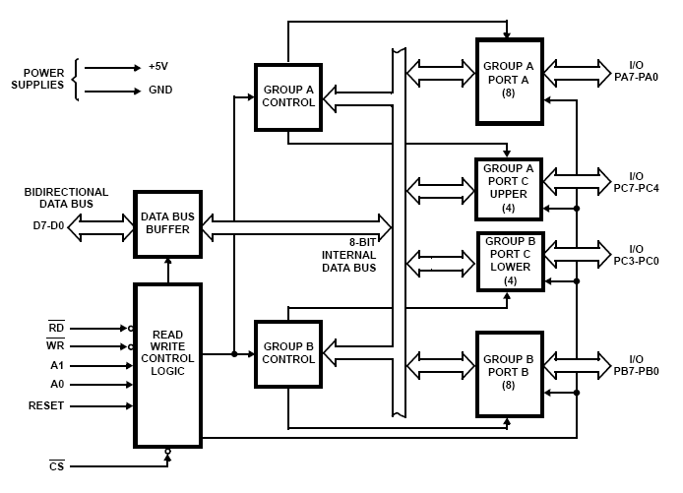
Block Diagram
GROUP A:
PortA
PortC Upper
GROUP B:
PortB
PortC Lower

Slide 13
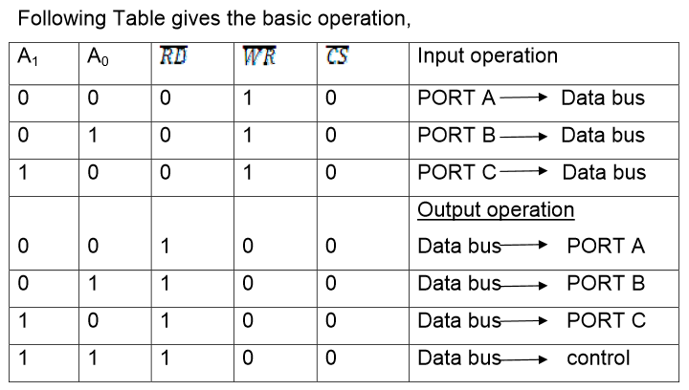

Slide 14
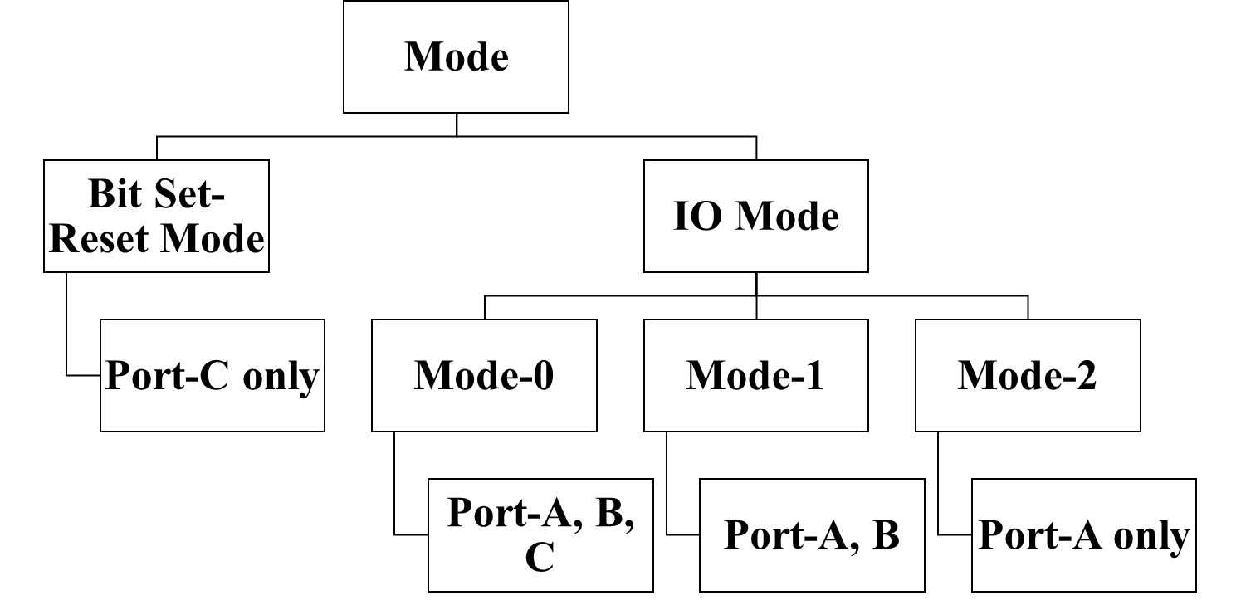
Mode
D7 | D6 | D5 | D4 | D3 | D2 | D1 | D0
‹#›

Slide 15
Mode 0
Outputs are latched
Inputs are buffered.
No handshaking
Port A, B, C all can work
‹#›

Slide 16
Latch
1. A latch is a digital IC which holds the data put into it, 1 or 0, until cleared.
2. Holds one bit (like a flip flop)
Buffer
1. Can cancel noise or modify input by the requirement of the circuit.
‹#›

Slide 17
Block Diagram

Slide 18
Group A and Group B control:
Group A and B get the Control
Signal from CPU and send the command to the individual control blocks.
Group A send the control signal to port A and Port C (Upper) PC7-PC4.
Group B send the control signal to port B and Port C (Lower) PC3-PC0.
PORT A:
This is a 8-bit buffered I/O latch.
It can be programmed by mode 0 , mode 1, mode 2 .
Notes:
Buffered I/O latch: Means buffered to keep power level and latched means will not changed until IO operation completed
‹#›

Slide 19
PORT B:
This is a 8-bit buffer I/O latch.
It can be programmed by mode 0 and mode 1.
PORT C:
This is a 8-bit Unlatched buffer Input and an Output latch.
It is splitted into two parts.
It can be programmed by bit set/reset operation.

Slide 20
Handshaking
Handshaking is a I/O control method to synchronize I/O devices with the microprocessor.
‹#›

Slide 21
Mode 0
Selected for the devices that does not require handshaking. (i.e. LED Light, Buzzer)
‹#›

Slide 22
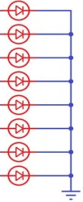
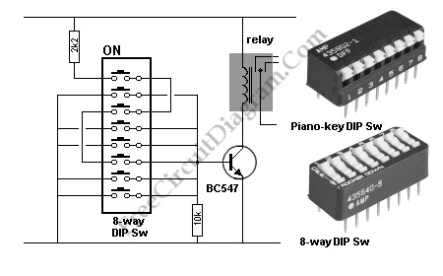
Writing to Control word for Mode-0
Port A (8 bit)
8 LED
MPU
10001001
8255
Control
Register
Read
Port B (8 bit)
Write
8 LED
A0
A1
Port C_{Upper} (4 bit)
Reset
Port C_{Lower} (4 bit)
Switches
Chip Select
1 | 0 | 0 | 0 | 1 | 0 | 0 | 1
Control Register
‹#›
Notes:
‹#›

Slide 23
Mode 1
Each port uses three lines from Port C as handshake signals. The other 2 (PC6, PC7) bits of port C can use as I/O signals.
PC3, PC4, PC5 helps Port A for Handshaking. PC0, PC1, PC2 helps Port B for Handshaking.
Port A and B functions as I/O.
‹#›

Slide 24
Block Diagram

Slide 25
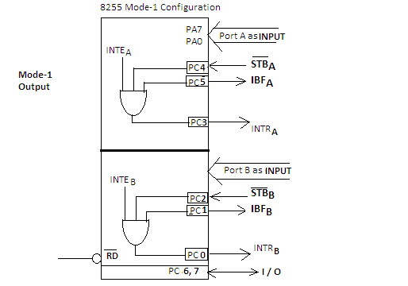
After the (Input Buffer Full) – Signal is received, Strobe Signal is disabled
Input Handshaking (mode 1)
Keyboard
8 bit ASCI value
(Strobe Signal) – Data is Being Sent
(Input Buffer Full) – Acknowledge of data receive. Don’t send anything until the data is processed.
Sends Microcontroller signal of data receive
Microcontroller sets A1, A0 as 0, 0 to select port A and RD’ as 0.
Once the Microcontroller reads the data, IBF signal is disabled. So keyboard sends next data

Slide 26
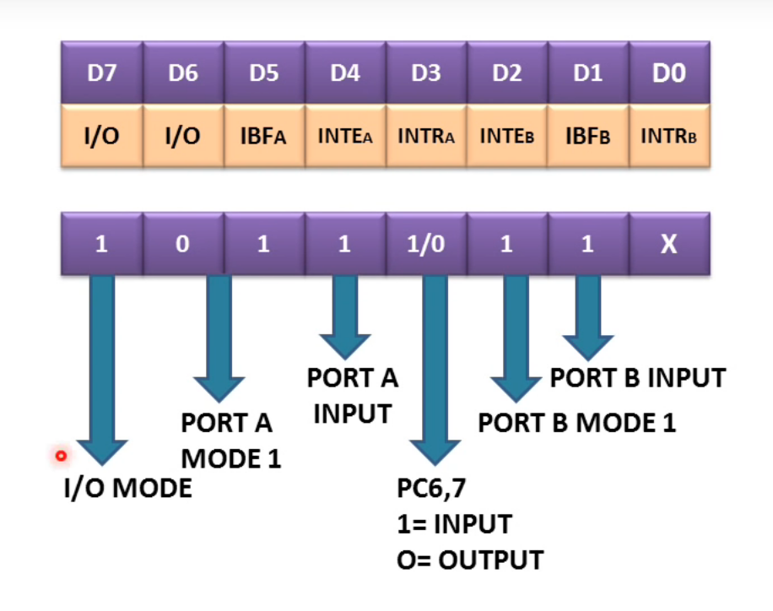

Slide 27
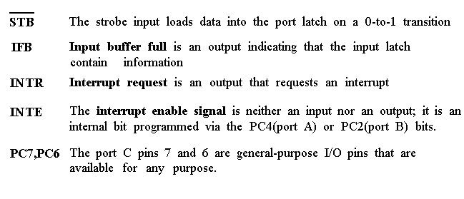
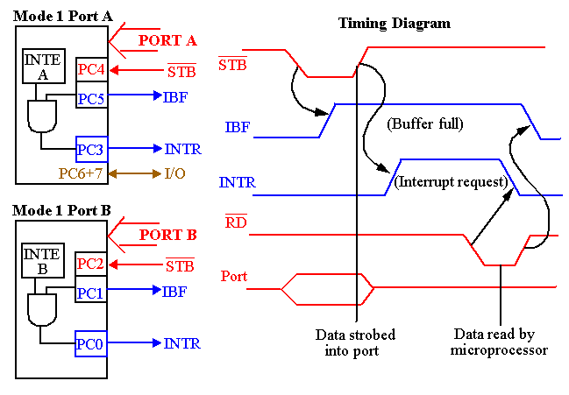

Slide 28
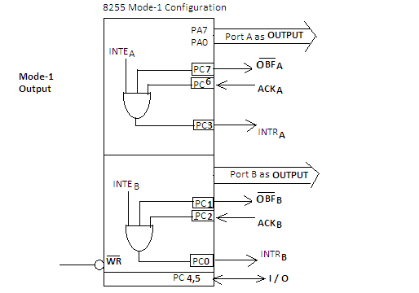
Output Handshaking (mode 1)
Printer
4. Output Buffer Full, OBF’=0 (sends signal to printer to print data)
5. When Printer Free, sends Acknowledgement (ACK’ = 0) signal
1. Interrupt signal is high when CPU is not sending any data
2. when the microprocessor acknowledges the interrupt,
3. Whenever the microprocessor enables Write pin, the interrupt pin gets disabled
3. activates Write pin (WR’=0), selects port A (A0=0, A1=0), sends data from data bus (D0 – D7)
6. When IC receives acknowledgement signal, output is passed through PortA. Simultaneously OBF is disabled.

Slide 29
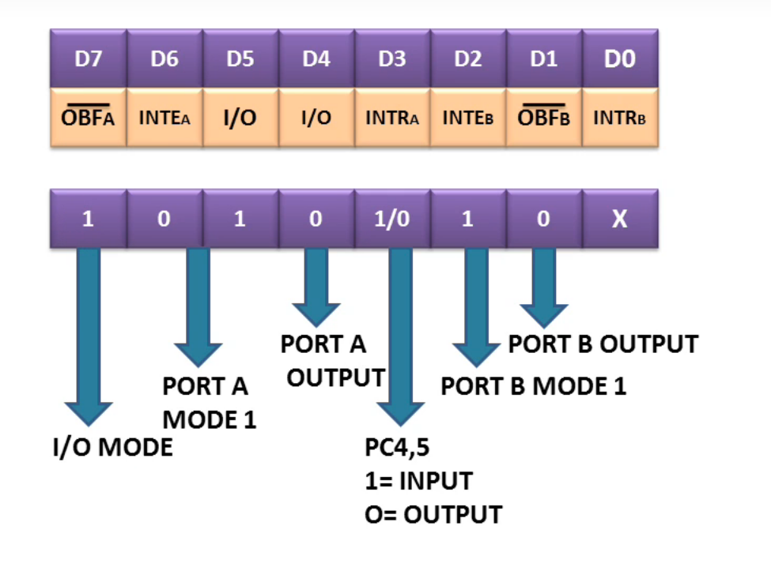

Slide 30
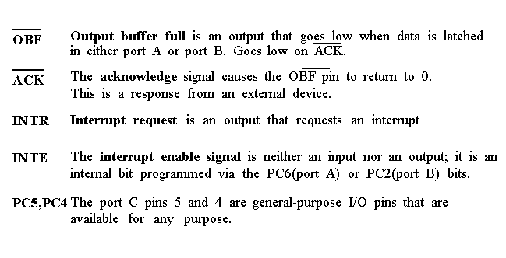
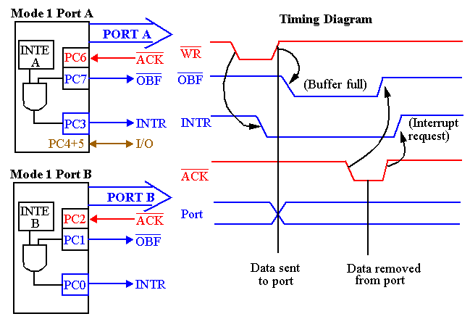

Slide 31


Writing to Control word for Mode-1
MPU
8255
Port A (8 bit)
1010X11X
Control
Register
Printer
Read 🡪 1
Write 🡪 0
Port C_{Upper} (Pin 3, 6, 7)
A0 🡪 1
Port B (8 bit)
A1 🡪 1
Reset 🡪 0
Keyboard
Chip Select 🡪 0
Port C_{Lower} (Pin 1, 2, 3)
1 | 0 | 1 | 0 | X | 1 | 1 | X
Control Register
‹#›
Notes:
‹#›

Slide 32
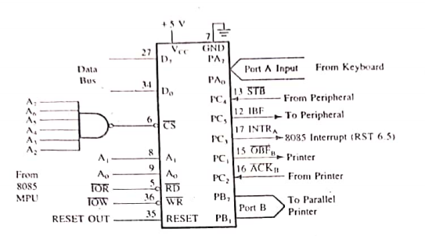
Mode 1 (Port A (input), Port B (Output)
D7 | D6 | D5 | D4 | D3 | D2 | D1 | D0
1 | 0 | 1 | 1 | X | 1 | 0 | X
‹#›

Slide 33
MODE 2:bi-directional I/O data transfer:
This mode allows bidirectional data transfer over a single 8-bit data bus using handshake signals.
This feature is possible only Group A
Port A is working as 8-biy bidirectional.
PC3-PC7 is used for handshaking purpose.
The data is sent by CPU through this port , when the peripheral request it.
When to Use Mode 2:
For devices which can take both input and output. Example: Mobile, pen drive, external hard drive

Slide 34
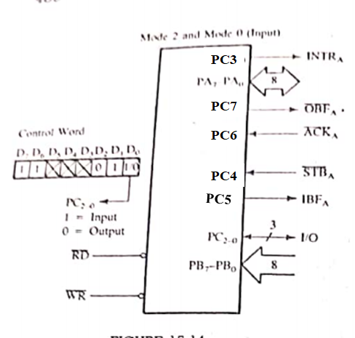
Mode 2 (port B mode 0)
Port A changes into input or output with clock pulse
PC7
‹#›

Slide 35
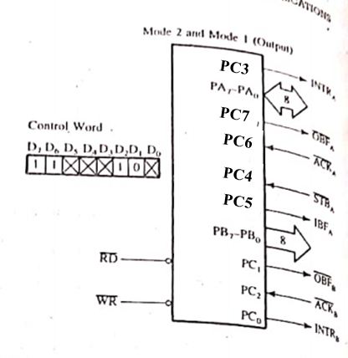
Mode 2 (port B mode 1)
Port A changes into input or output with clock pulse
‹#›

Slide 36

Writing to Control word for Mode-2
MPU
8255
Port A (8 bit)
11XXX1XX
Control
Register
Touch
Screen
Read 🡪 1
Write 🡪 0
Port C_{Upper} (Pin 3, 4, 5, 6, 7)
A0 🡪 1
Port B (8 bit)
A1 🡪 1
Reset 🡪 0
Keyboard
Chip Select 🡪 0
Port C_{Lower} (Pin 1, 2, 3)
1 | 1 | X | X | X | 1 | X | X
Control Register
‹#›
Notes:
‹#›

Slide 37
Programming 8255
Mode 0:
Ports A, B, and C can be individually programmed as input or output ports
Port C is divided into two 4-bit ports which are independent from each other
Mode 1:
Ports A and B are programmed as input or output ports
Port C is used for handshaking
PA[7:0]
PA[7:0]
PC4
STB_{A}
PC7
OBF_{A}
PC5
IBF_{A}
PC6
ACK_{A}
PC3
INTR_{A}
PC3
INTR_{A}
8255
PB[7:0]
8255
PB[7:0]
PC2
STB_{B}
PC2
OBF_{B}
PC1
IBF_{B}
PC1
ACK_{B}
PC0
INTR_{B}
PC0
INTR_{B}
PC6, 7
PC4, 5
11-‹#›

Slide 38
Programming 8255
Mode 2:
Port A is programmed to be bi-directional
Port C is for handshaking
Port B can be either input or output in mode 0 or mode 1
PA[7:0]
PC7
OBF_{A}
PC6
ACK_{A}
PC4
STB_{A}
8255
PC5
IBF_{A}
PC3
INTR_{A}
PC0
In Out
In Out
In Out
STB_{B} OBF_{B}
IBF_{B} ACK_{B}
INTR_{B} INTR_{B}
PC0
PC0
PB[7:0]
Mode 0
Mode 1
Can you design a decoder for an 8255 chip such that its base address is 40H?
Write the instructions that set 8255 into mode 0, port A as input, port B as output, PC0-PC3 as input, PC4-PC7 as output ?
11-‹#›

Slide 39
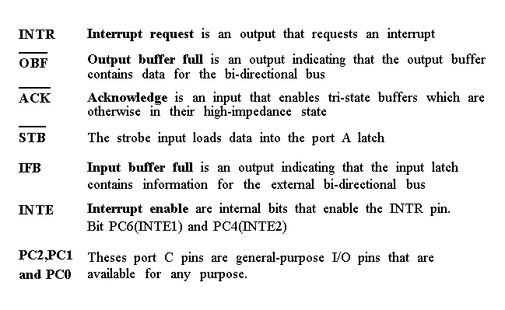
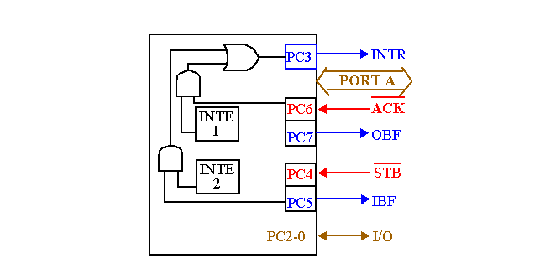
Timing diagram is a combination of the Mode 1 Strobed Input and Mode 1 Strobed Output Timing diagrams.

Slide 40
Thank you
Q&A

